Slide 1
10 things I kind of believe about conflict and governance
(sometimes even with evidence)
Chris Blattman • Yale University • September 2010 • Presentation to IRC “Governance Re-think Workshop”

Slide 2
1. Civil war is on the decline
We’ll hope the trend continues

Slide 3
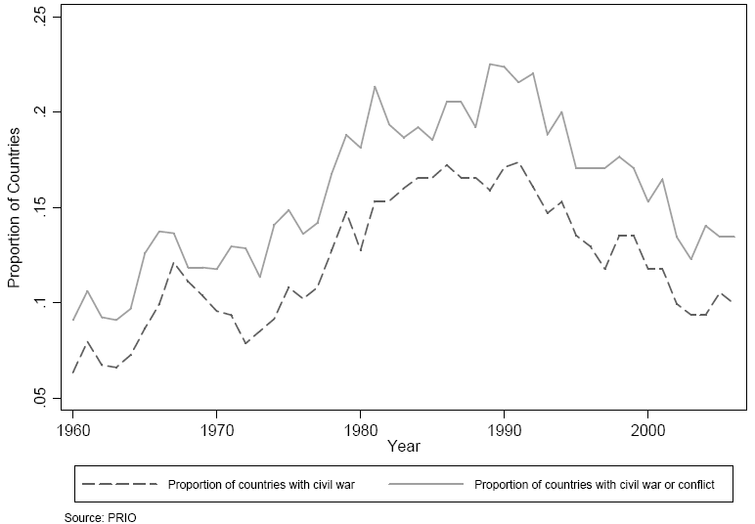
Proportion of countries with an active civil war or conflict, 1960-2006

Slide 4
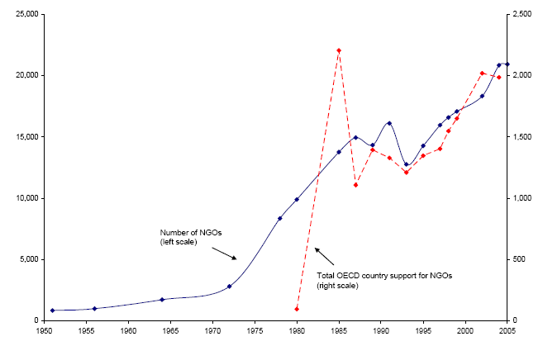
But some things are on the rise
Growth of international NGOs, 1950-2005
Number of NGOs
(left axis)
OECD aid to NGOs
(right axis)
Werker &Ahmed. 2008. "What do nongovernmental organizations do?" Journal of Economic Perspectives 22 (2):73-92.

Slide 5
Fewer conflicts
A more crowded NGO space
A good moment for strategic thinking

Slide 6
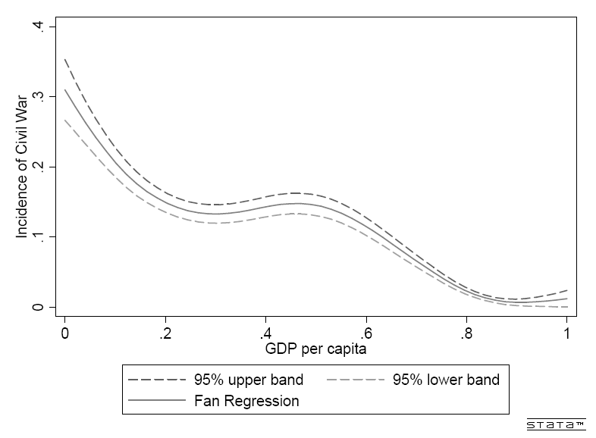
Poverty would seem to be the biggest driver of war
Incidence of civil war, by income per capita (1960-2006)
Blattman, C. and E. Miguel (2010). "Civil War." Journal of Economic Literature 48(1): 3-57.

Slide 7
2. But there’s no evidence that poverty causes conflict
Things correlated with poverty are more likely culprits

Slide 8
Why should we be skeptical that poverty → conflict?
Once you account for other factors, the poverty correlation goes away
Sudden shocks to national income don’t seem to cause conflict
  E.g. trade and commodity price shocks
  Rainfall shocks lead to conflict, but very weakly and historically

Slide 9
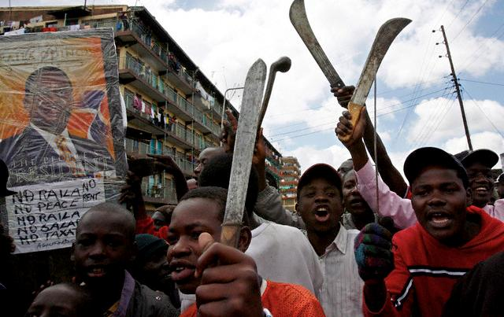
Hey – What about these guys?

Slide 10
3. Actually, poor and unemployed young men don’t seem to be a source of social instability
The triumph of theory and intuition over evidence

Slide 11
The short story
The people who riot and fight are poor unemployed young men
The people who do not riot are poor, unemployed young men
There isn’t much evidence of a relationship between income and the propensity to riot or fight

Slide 12
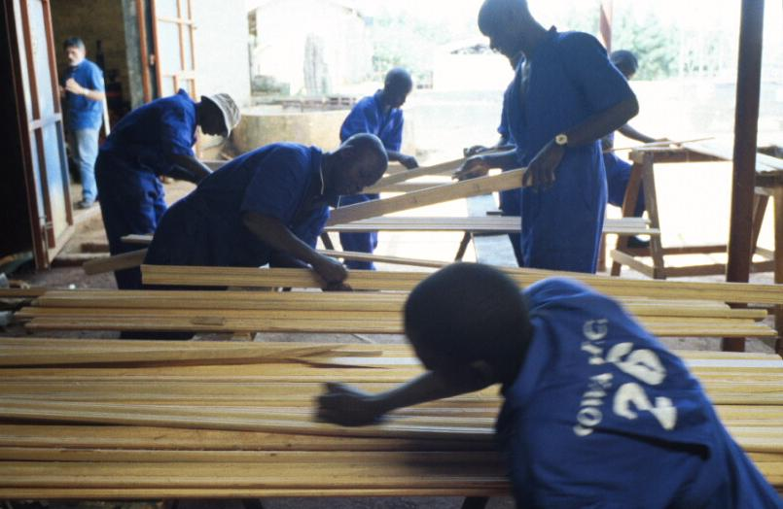
Does employment ↓ violence?
Northern Uganda: Experimental evaluation of a vocational training program for 10,000 youth

Slide 13
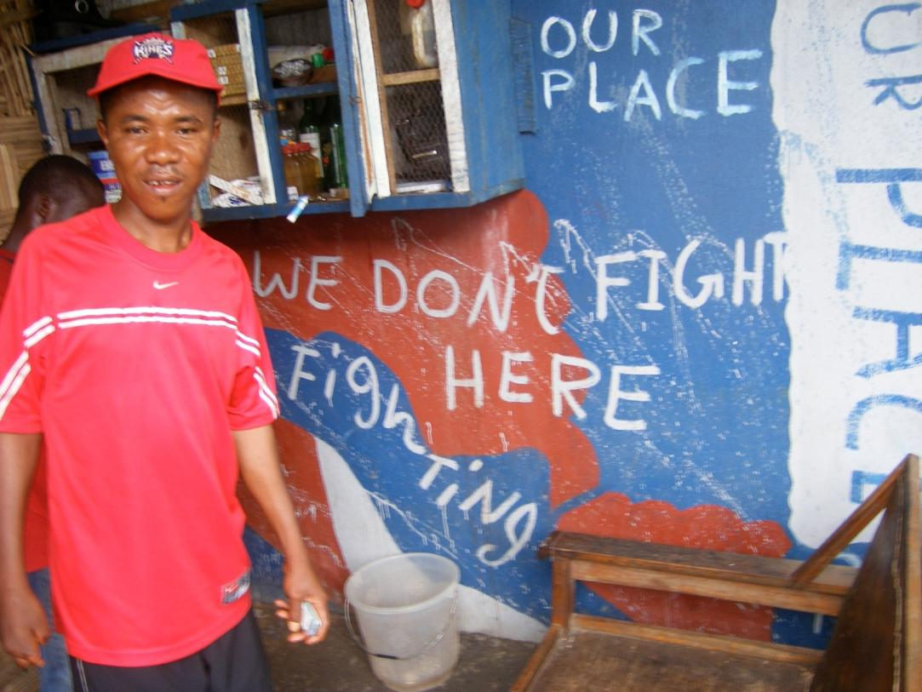
The solution may be non-economic
Monrovia: Experimental evaluation of a behavior change and cash transfer program for street youth

Slide 14
4. Conflict and violence are at root a governance failure
Lack of Security
Absence of Justice
Illegitimate and unaccountable rulers

Slide 15
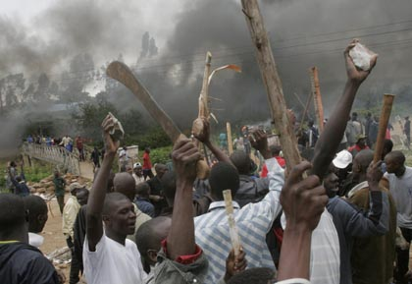
Is this a consequence of poverty, or the absence of effective security and control?
Notes:
If you read a historical account of civil war, inevitably you will read of deep-seated hatreds and rivalries, injustices, and disputes
The roots of such grievances are legion: Ethnic hatreds, Inequality, Injustice, Ideology
These grievances may be very important in building viable movements. They may help movements recruit young men and women cheaply to their cost. They may even be a necessary conditoin for war
What is surprising is that whenever we have tried to measure these grievances on a large, systematic scale across countries, they almost never correlate with a higher risk of civil war

Slide 16
It’s mostly correlations and historical cases, but:
Strong states—democracies and autocracies—seldom see internal war
Some of the best predictors of conflict:
  Below-average quality of governance (for the income level)
  Uncompetitive executive controlled by minority factions
  Transitional regimes

Slide 17
This makes sense
War is costly
Competing groups usually negotiate a solution
When does negotiation break down?
  Personal rule: leaders care more about themselves than the state or populace
  Weak governments can’t make strong commitments
  Injustice escalates passions

Slide 18
5. The MDGs and good governance may be at cross-purposes
Law and order are the first and most basic functions of the state…
…but are the last item on the development agenda

Slide 19
What’s missing?
Eradicate extreme poverty and hunger
Achieve universal primary education
Promote gender equality and empower women
Reduce child mortality
Improve maternal health
Combat HIV/AIDS, malaria, and other diseases
Ensure environmental sustainability
Develop a global partnership for development

Slide 20
When did the UK and US have income levels similar to today’s fragile states?
Source: Lant Pritchett and Frauke de Weijer (2010) “Fragile States: Stuck in a Capability Trap?” WDR 2011 background paper.

Slide 21
A 20th century welfare system on a 16th century state structure?

Slide 22
6. Elections do not good governance make
We shouldn’t confuse processes with outcomes
Assuming this is even the priority outcome

Slide 23
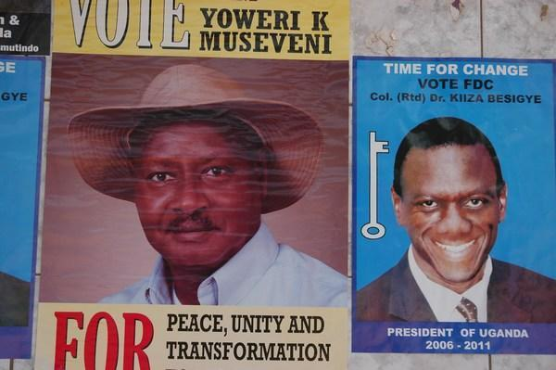
The “ritual of democracy”
  “Giving aid donors an election barely clean enough to receive a low passing grade, but dirty enough to make it difficult for the opposition to win.”
  - Marina Ottaway

Slide 24
What are the broader preconditions that foster state capabilities and management?
Systems of conflict resolution
Systems of downward accountability
Relatively impersonal, professional bureaucracies
Elites with a vested interest in growth and peace
…

Slide 25
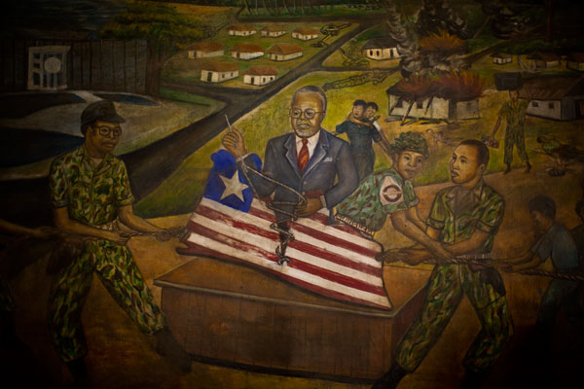
Centralized, personalized rule anathema to political stability

Slide 26
The evolution of checks and balances
Kenya
Liberia
War averted by settlement
Autonomous middle class and business interests
Legislature asserting independence
Judiciary exercising voice
Vibrant free press
New constitution
Legislature now elected
Push to devolve powers
Budding press
Judiciary recobering
National commissions defying government
But private sector still weak

Slide 27
Polycentric governance
Make the state more difficult to capture
Partly decentralization
But not just decentralization
Local elections
Local budgetary power
Local taxation and regulation
Local accountability
Global law and institutions
Regional security and economic apparatus
Professional bureaucracies
International NGOs as observers
Vibrant civil society

Slide 28
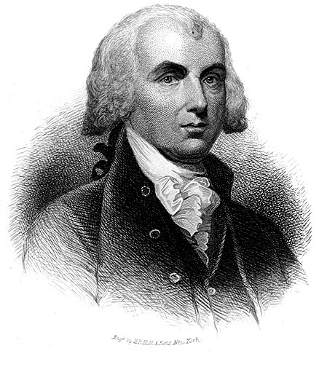
“Ambition must be made to counteract ambition.”
– James Madison
Federalist Paper no. 51
(Not necessarily a recipe for efficiency and effectiveness.)

Slide 29

Interlude:
Name that developing country President
?

Slide 30
You get 5 clues
Elections marred by fraud and intimidation
Final count was disputed in four regions, three of which were under military occupation by a supportive commander
The inauguration ceremony was held in secret because of fears of an insurrection
Troops killed dozens while quelling protests over his reign
Half his children died of tropical disease before reaching second birthday

Slide 31
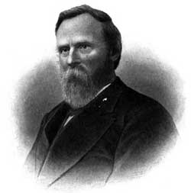
Rutherford B. Hayes
19th President of the USA (1877-81)

Slide 32
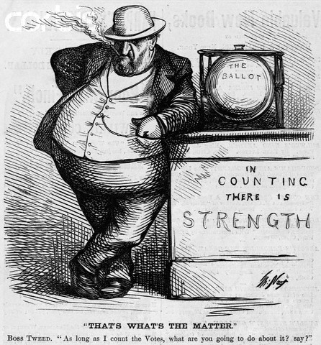

Slide 33
7a. Political development, like economic development, evolves slowly
Political stability is more important to development than lower corruption or cleaner elections

Slide 34
7b. Good governance will take a long, long time
Implication: We need to lower our have appropriate expectations of fragile states

Slide 35
How long will it take the average fragile state to get to the governance levels of a Kenya, Botswana or Vietnam?
Source: Lant Pritchett and Frauke de Weijer (2010) “Fragile States: Stuck in a Capability Trap?” WDR 2011 background paper.

Slide 36
8. Institutions develop through internal forces, not foreign NGOs
Social movements
Conflict
Party and political organization

Slide 37
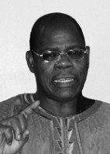
“There is really only one process of democratization, and that is a process of struggle. Democracy is never given, it is always taken.”
— Claude Ake

Slide 38
Will historians look back on Kenyan election violence as a tragedy or a milestone?

Slide 39
9. Just being there may be a governance intervention
Sometimes NGOs are the only impersonal, professional meritocracy in town

Slide 40
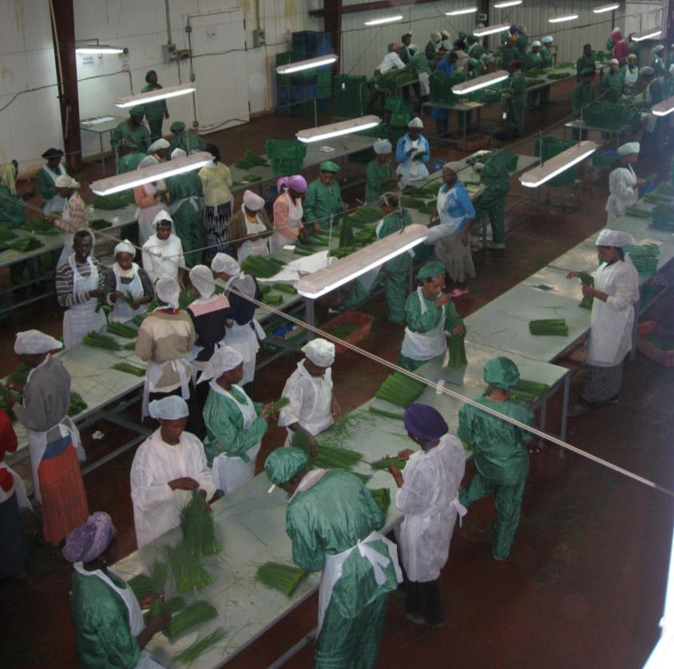
In developing country business, the scarce resource is management.
(Businesses are not the only ones)

Slide 41
Bureaucracy, like management, is a technology and a culture
Bureaucracy once had a good connotation
  Systems of impersonal, professional rule
  Norms and cultures of compliance
  Meritocratic
Diffuses slowly
  Shifting norms, accumulating experience
Outside the capital, international NGOs may be the primary

Slide 42
10. We don’t really know how to build better governance systems
(but that doesn’t mean we shouldn’t try)

Slide 43
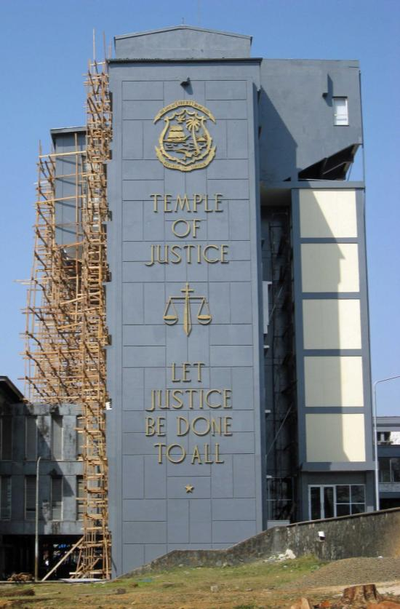
Among the many important things we don’t know how to do well:
Help resolve land disputes
Promote accountability of local officials
Build community organizational capacity
Foster social movements
Build judicial capacity
Strengthen political parties
Bolster a free press

Slide 44
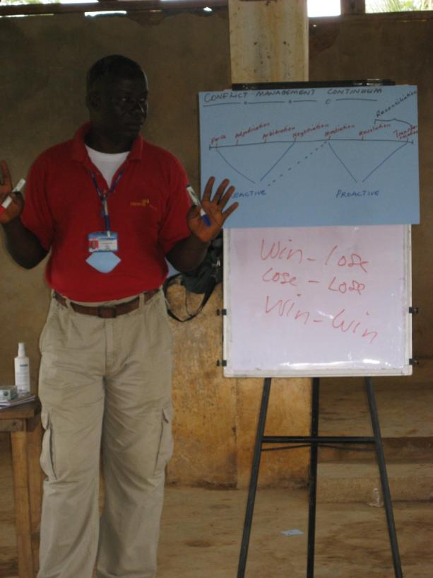
Some things we spent a lot of money on, and we’re not sure if they make a difference
Civic education and trainings
CDR / CDD
Building public buildings
Social norms messaging (especially on human rights)
Employment programs

Slide 45
International NGOs have advantages and disadvantages
Advantages
Disadvantages
Longer time horizons
Humanitarian incentives
Not susceptible to the (local) political cycle
Not accountable to local strongmen
Resources
Weak local knowledge
No mechanism for downward accountability
Transparency standards incompatible with local systems

Slide 46
Implications for international NGOs
This is a local process you can (at best) support
It’s harder than most of the things you do
Do it seriously or don’t mess around
Do no harm
Have realistic expectations
Avoid premature load bearing
Experiment and evaluate
Foster local partnerships and people

